Slide 1
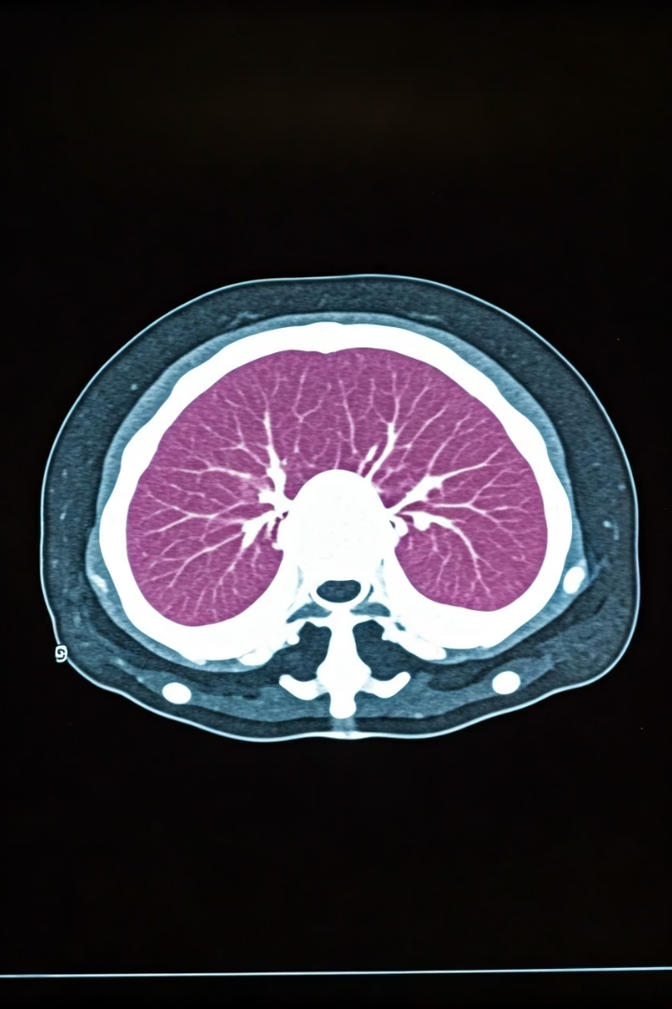
Enhanced U-Net for Spleen Segmentation in CT Scans: Integrating Multi-Slice Context and Grad-CAM Interpretability
Project Overview:
Focus on accurate spleen segmentation in abdominal CT scans
Uses Enhanced U-Net with multi-slice contextual input
Trained on the Medical Decathlon dataset
Key Innovations:
Inputs include three adjacent CT slices as RGB channels
Uses a hybrid loss: Dice loss + Binary Cross-Entropy
Integrates Grad-CAM for visual interpretability
Performance:
Achieved Dice similarity coefficient: 0.923 ± 0.04
Outperforms standard 2D segmentation models
Maintains computational efficiency
Presenters: Sowad Rahman, Khaled Karim, Aalavi Mahin Khan

Slide 2




Clinical Significance and Technical Challenges
Clinical Applications
Technical Challenges
Current Limitations
Splenic volumetry serves as an important biomarker for portal hypertension, lymphoma staging, and trauma assessment. Automated segmentation enables rapid treatment decisions and longitudinal disease tracking.
The spleen presents unique segmentation difficulties due to variable morphology, low contrast with surrounding tissues, and proximity to similarly-attenuating structures like the stomach and left kidney.
Manual segmentation is time-consuming and subject to inter-observer variability. Standard U-Net architectures struggle with slice thickness variations and different contrast phases.

Slide 3
Literature Review and State-of-the-Art Comparison
Traditional Methods
Deep Learning Evolution
Performance Comparison
Early approaches relied on adaptive thresholding and morphological operations, achieving Dice coefficients around 0.82. Shape-constrained geodesic active contour models incorporated prior shape information but showed limited robustness.
Recent deep learning approaches have demonstrated superior performance. 3D U-Net variants achieved Dice scores over 0.95 for liver segmentation, while UNet++ with nested dense skip connections showed 2% improvement in multi-organ tasks.
Our enhanced U-Net achieves 0.923 Dice score compared to standard U-Net (0.891), nnU-Net (0.915), and TransUNet (0.913), while maintaining computational efficiency and simpler architecture than nested variants.

Slide 4
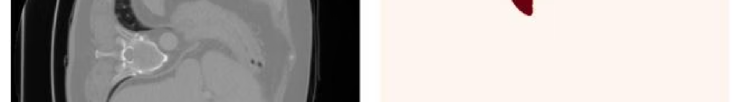




Dataset and Preprocessing Pipeline
Medical Decathlon Dataset
61 contrast-enhanced abdominal CT scans (41 training, 20 validation) with manual spleen annotations. Average of 100 slices per case with slice thickness ranging 1.5-7.5mm.
CT Windowing
Raw CT values windowed using center=150, width=500 (corresponding to -100 to 400 HU) to enhance soft tissue contrast and optimize spleen visualization.
Multi-Slice Input
Three adjacent slices combined as RGB channels providing contextual information while maintaining 2D processing efficiency. Boundary slices duplicated when needed.
Data Augmentation
Random rotation (±10°), translation (±10%), and horizontal flipping applied with 0.7 probability during training to improve generalization.

Slide 5
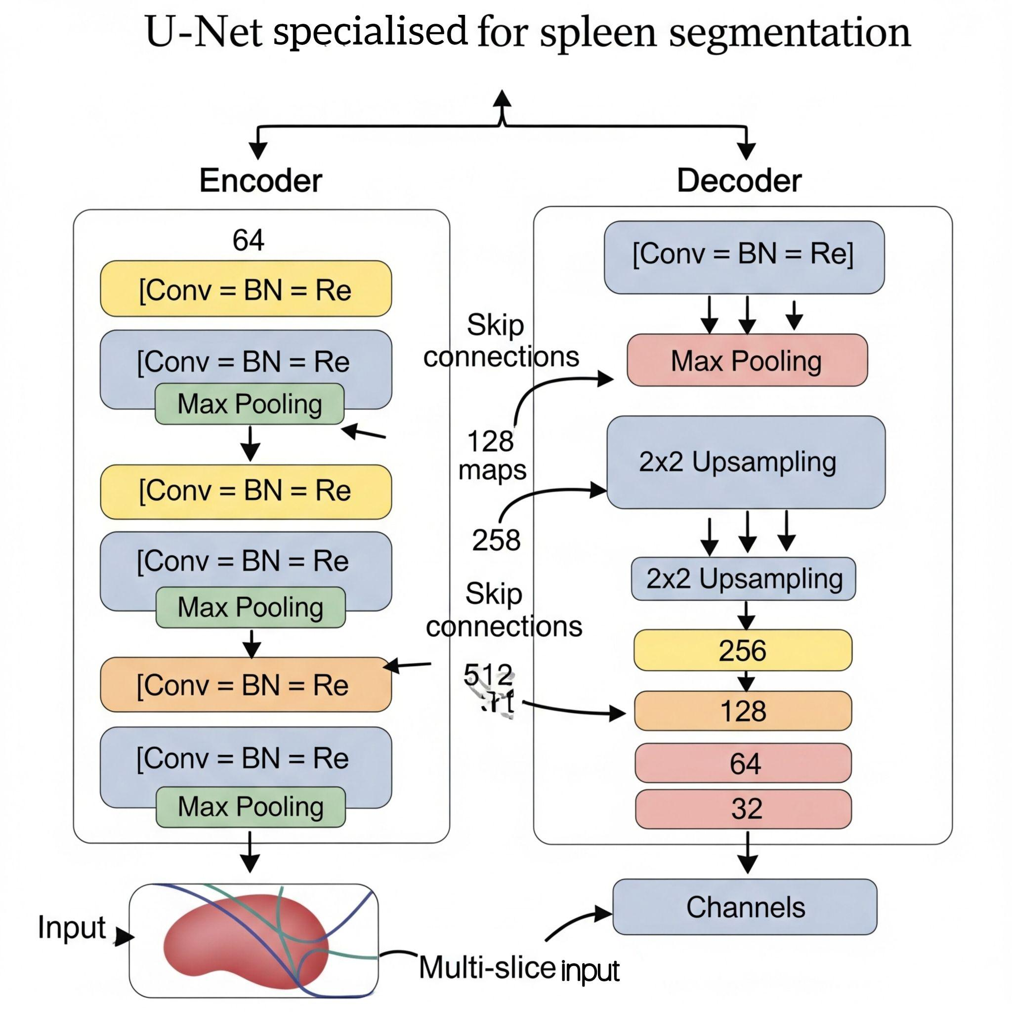
Enhanced U-Net Architecture
Encoder Path
Decoder Path
Four convolutional blocks with feature map depths [64, 128, 256, 512]. Each block contains two Conv2D layers with batch normalization, ReLU activation, and max pooling for hierarchical feature extraction.
Symmetric decoder with four upsampling blocks using bilinear upsampling, skip connections, and convolutional layers. Preserves spatial details through concatenation with encoder features.
Combined Loss Function
Hybrid loss balancing binary cross-entropy and Dice loss (λ=0.5) to optimize both region-based and boundary-based segmentation accuracy with numerical stability.

Slide 6
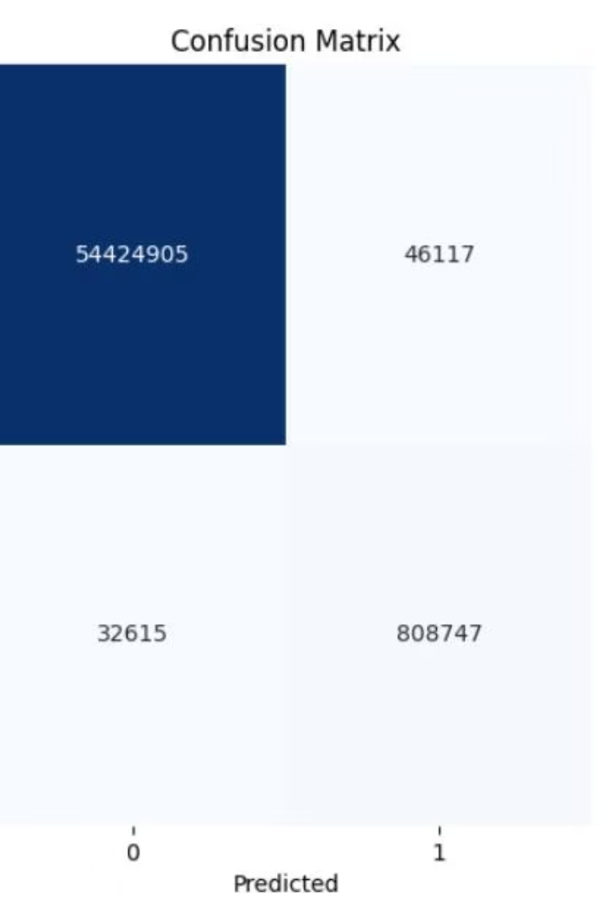
Understanding the Confusion Matrix
What the Numbers Mean
🔹True Negatives (Top-Left): 54.4M non-spleen pixels correctly predicted.
🔹True Positives (Bottom-Right): 808k spleen pixels correctly predicted.
🔹False Positives (Top-Right): 46k background pixels wrongly marked as spleen.
🔹False Negatives (Bottom-Left): 32k spleen pixels missed.
🔹 A confusion matrix compares actual vs. predicted labels. 🔹 Here, it shows how well our model identifies spleen (1) and non-spleen (0) pixels. 🔹 Helps us see correct and incorrect predictions in one glance.
Model Performance Insight
🔹Very high accuracy, especially for non-spleen detection.
🔹Spleen is well detected with few misses.
🔹Most mistakes happen near organ boundaries, which is expected.
🔹Overall, this matrix proves our model is reliable and precise.

Slide 7
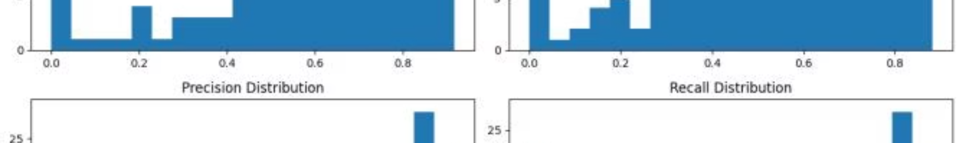
Quantitative Results and Performance Analysis
0.923
0.997
Dice Score
Specificity
Mean performance with ±0.04 standard deviation
High precision minimizing false positives
9.47
0.938
Hausdorff Distance
Normal Spleen
Average surface distance in millimeters
Best performance on healthy cases
The model demonstrates robust performance across varying slice thicknesses and contrast phases. Performance is highest for normal spleens (0.938) and thin-slice acquisitions (0.932), with slight decreases for pathological cases like post-trauma spleens (0.901).

Slide 8
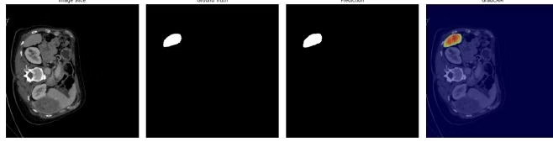








Grad-CAM Interpretability and Visual Analysis
Vascular Structures
Failure Modes
Model attends to vascular structures within the spleen for accurate boundary detection
Analysis shows confusion at kidney interfaces and reduced attention at thin splenic poles
Network Attention
Grad-CAM reveals focus on spleen parenchyma-to-capsule transitions and interfaces with surrounding organs
Clinical Insights
Visualization enhances model interpretability and informs preprocessing refinements

Slide 9

Conclusions and Future Directions
Key Achievements
Enhanced U-Net achieves 0.923±0.04 Dice coefficient, outperforming standard 2D approaches by 2.3-3.2% through multi-slice inputs, combined loss function, and comprehensive augmentation strategies.
Clinical Impact
High specificity (0.997) and sub-5% volumetric errors make the system suitable for clinical applications including splenic volumetry, trauma assessment, and longitudinal disease monitoring.
Future Enhancements
Planned improvements include hybrid 2D-3D architectures for better contextual information, expanded pathological training data, attention mechanisms for organ differentiation, and external dataset validation.

Slide 10
Resources and dataset links:
dataset download link: https://drive.google.com/file/d/1jzeNU1EKnK81PyTsrx0ujfNl-t0Jo8uE/view?usp=drive_link
dataset official website:
http://medicaldecathlon.com/
kaggle link: https://www.kaggle.com/code/dead2238/notebook5ba08d69cc/notebook?scriptVersionId=237606181
Github link:
https://github.com/sowad223/ML-and-DL-projects/tree/main/CSE463/CSE463_PROJECT

